Slide 1
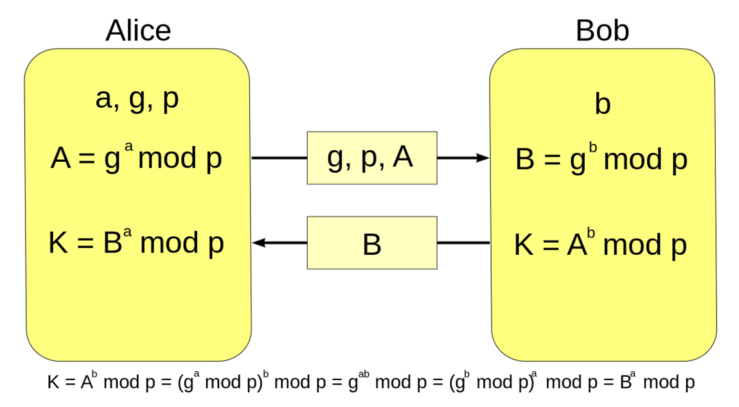
Diffie-Hellman Key Exchange (DH)
Diffie-Hellman and Module Arithmetic

Slide 2

Diffie–Hellman Key Exchange (DH)
Securely exchanging cryptographic keys
Over a public (insecure) channel
One of the first public-key protocols
Allows two parties to exchange data securely
The Diffie–Hellman (DH) method allows
Two parties that have no prior knowledge of each other
Jointly establish a shared secret key over an insecure channel

Slide 3
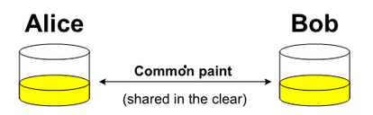


Key Exchange by Mixing Colors
Alice and Bob, agree on an arbitrary starting color that does not need to be kept secret
Each of them selects a secret color that they keep to themselves
Finally Alice and Bob mix their secret color together with their mutually shared color

Slide 4
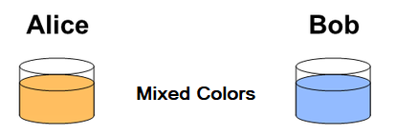
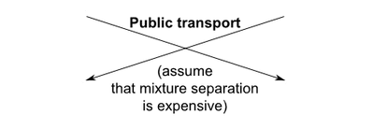


Key Exchange by Mixing Colors (2)
Publicly exchange the two mixed colors
Finally, each of the two mix together the color they received from the partner with their own private color
The result is a final color mixture yellow-brown that is identical to the partner's color mixture
If a third party listened to the exchange, it would be computationally difficult for them to determine the secret colors

Slide 5
DH Key Exchange: Modular Arithmetic
Alice and Bob agree to use a modulus p = 23 and base g = 5
Alice chooses a secret integer a = 4, then sends Bob A = gª mod p
A = 5⁴ mod 23 = 4
Bob chooses a secret integer b = 3, then sends Alice B = g^{b} mod p
B = 5³ mod 23 = 10
Alice computes s = Bª mod p
s = 10⁴ mod 23 = 18
Bob computes s = A^{b} mod p
s = 4³ mod 23 = 18
Alice and Bob now share a secret number s
s = (gª)^{b} mod p = (g^{b})ª mod p
s = 18
s cannot be computed from A and B
Video: youtu.be/M-0qt6tdHzk

Slide 6
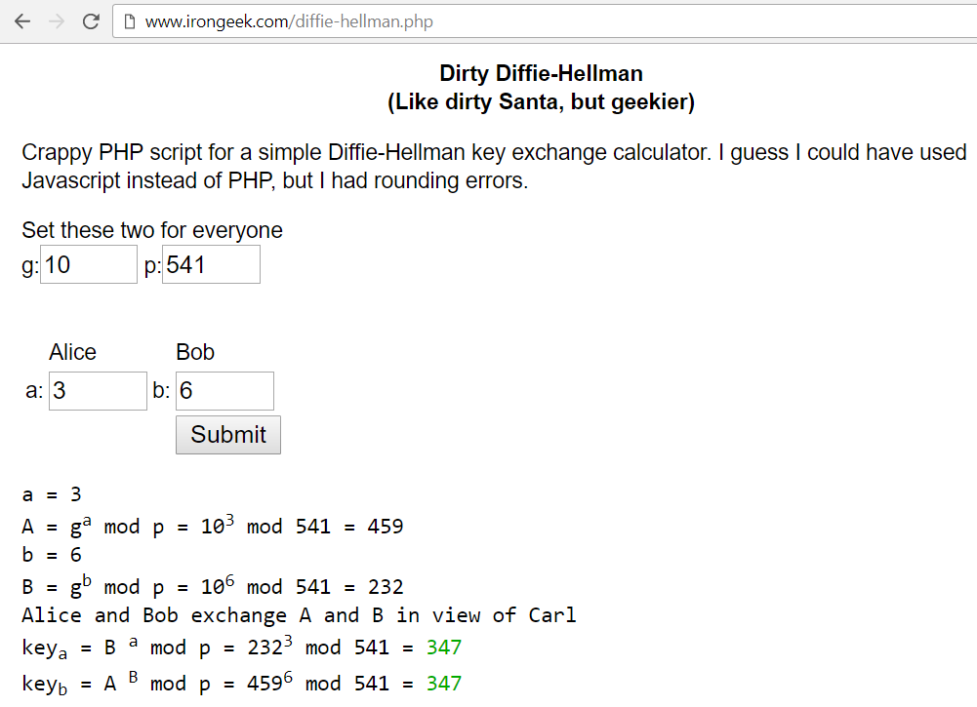
Diffie-Hellman Key Exchange
Live Demo
http://www.irongeek.com/diffie-hellman.php

Slide 7

Diffie-Hellman Key Exchange (DH)
Try the Demo!

